Slide 1



The Good News
The Bad News
What we can do about it
IEEE Mission: to foster technological innovation and excellence for the benefit of humanity.
IEEE Vision: be essential to the global technical community and to technical professionals everywhere, and be universally recognized for the contributions of technology and of technical professionals in improving global conditions.
Advancing Technology for Humanity
Visualizing sustainable solutions

Slide 2
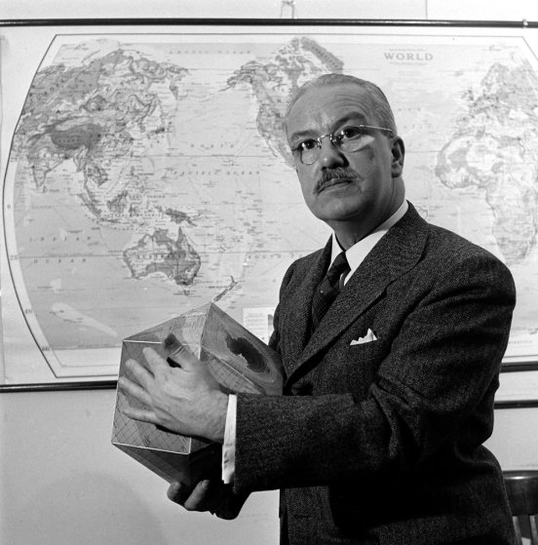
.
How do we make the world work
for 100% of humanity
in the shortest possible time
through spontaneous cooperation
without ecological damage
or disadvantage to anyone.
World GameTM mission
This question is the foundation for
the work of GENI and the SIMCenter
Buckminster Fuller 1895 -1993
Visualizing sustainable solutions

Slide 3
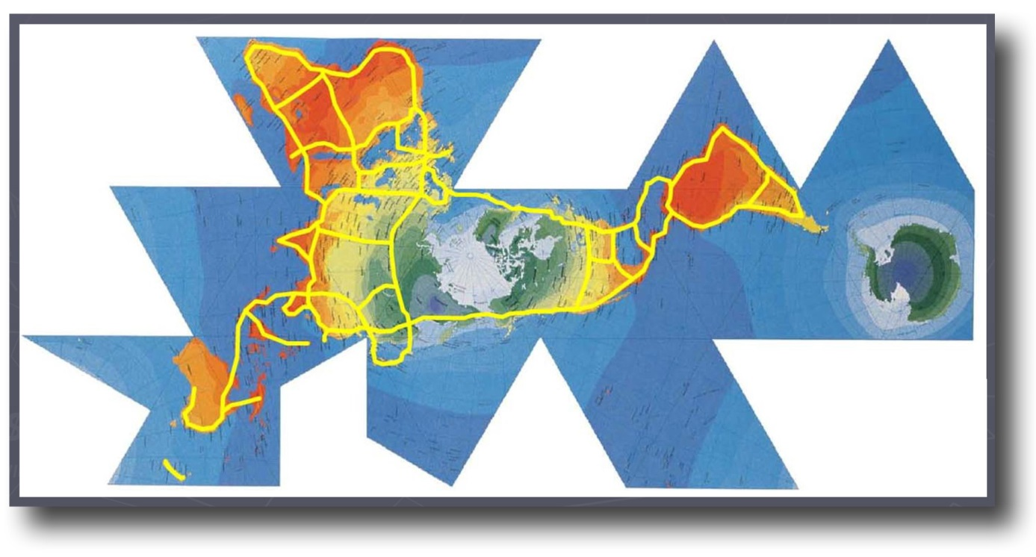
“Highest priority objective” – tap abundant renewable energy resources around the world and link grids via high-voltage transmission.
Dymaxion Map – © Buckminster Fuller Institute
Visualizing sustainable solutions

Slide 4
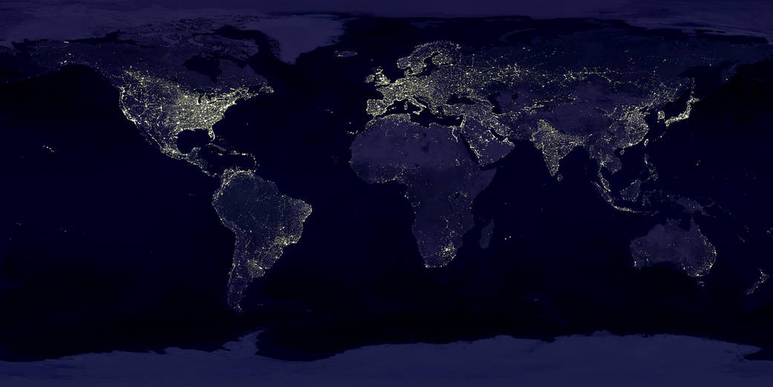
Earth from Space
What do we see – and not see?
NASA
Visualizing sustainable solutions

Slide 5
Wealthy vs. Poor
1.3 billion people still have no electricity
Visualizing sustainable solutions

Slide 6
Key Distinctions
Not all lights are equal.
75% of these lights are powered by fossil fuels or nuclear, creating long term atmospheric or toxic pollution -- except…
Visualizing sustainable solutions

Slide 7
Renewable Energy leadership
Iceland 100%
Norway 99%
Canada 60%
Costa Rica 99%
Brazil 81%
Uruguay 95%
New Zealand 80%
Hydro, wind, solar and geothermal interconnected via high-voltage energy grids
Visualizing sustainable solutions

Slide 8
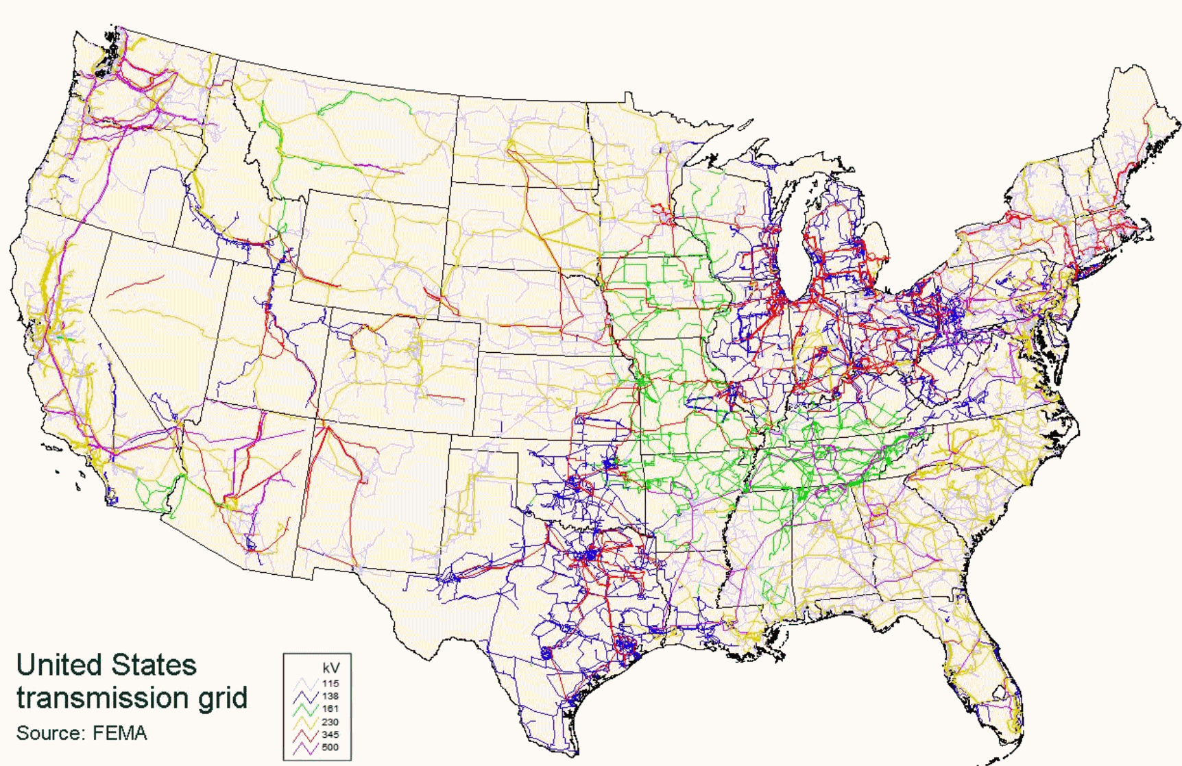
High-voltage transmission networks in U.S. Western, Eastern and Texas
Visualizing sustainable solutions

Slide 9
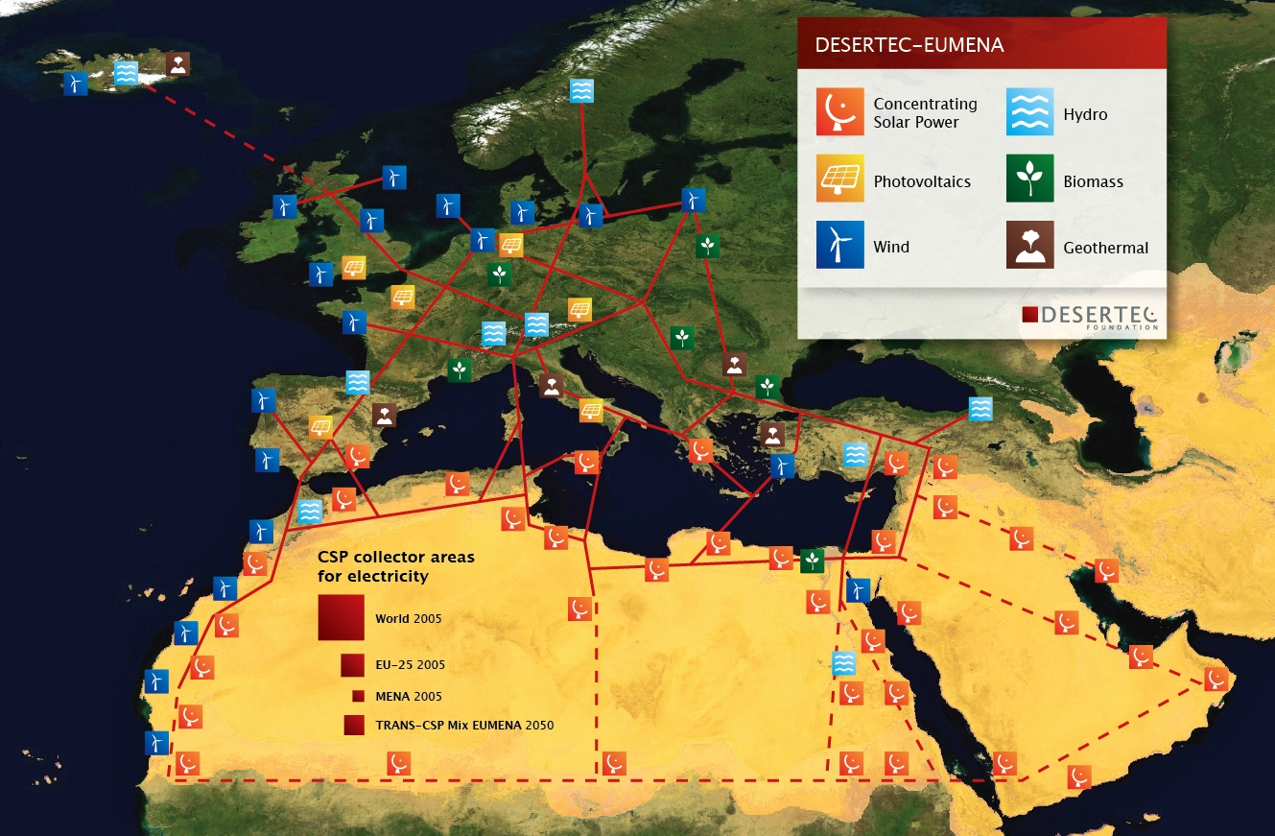
100% Renewable Energy . . . is there enough?
World
EU-25
MENA
Trans-CSP mix EUMENA
There’s solar
potential
beyond our
dreams
Visualizing sustainable solutions

Slide 10
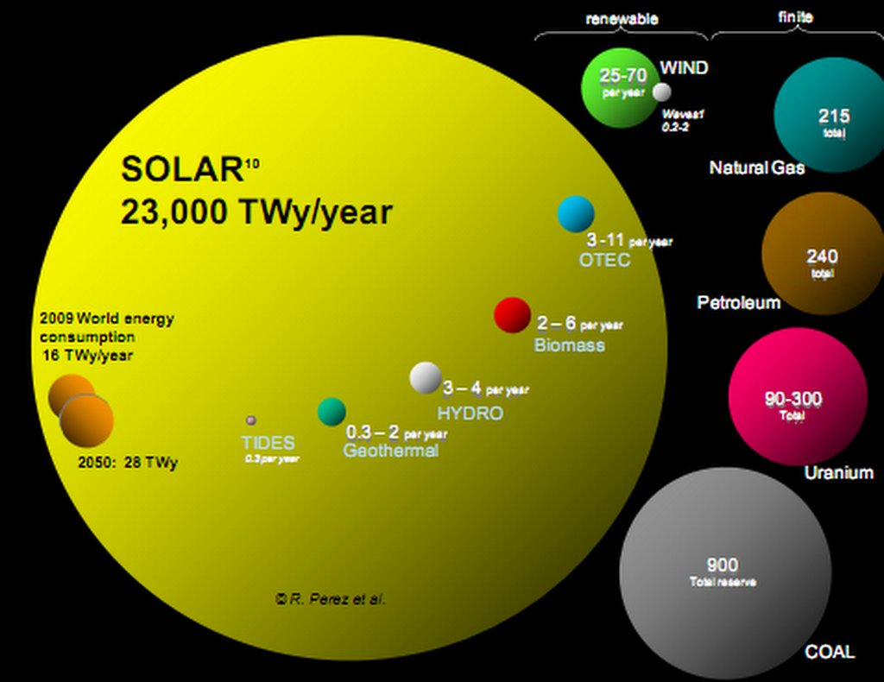
The Renewable Energy Potential of our planet is 1,500x our needs
The amount of sunlight received in one hour,
if converted to electrical energy, would meet the world’s power demand
for one year!
IEA
Visualizing sustainable solutions

Slide 11
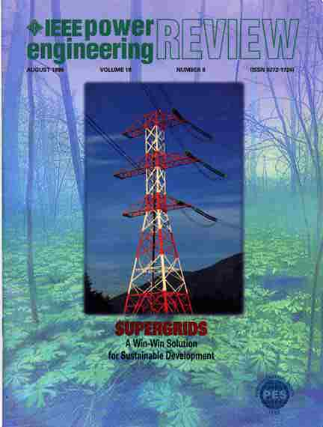
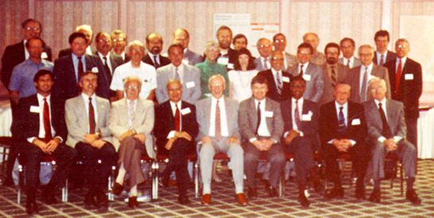

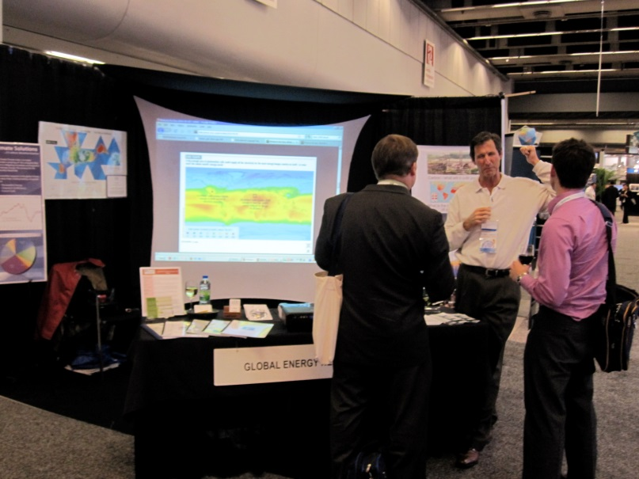
IEEE panels, CIGRE exhibit, Magazine features, World Energy Congress
GENI pushed this initiative around the world.
Visualizing sustainable solutions

Slide 12
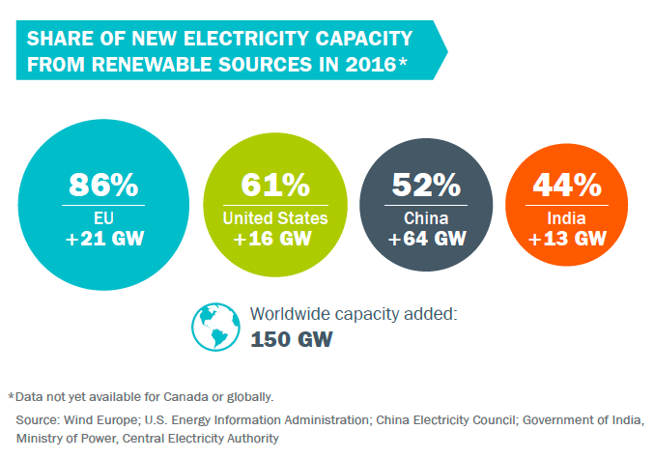
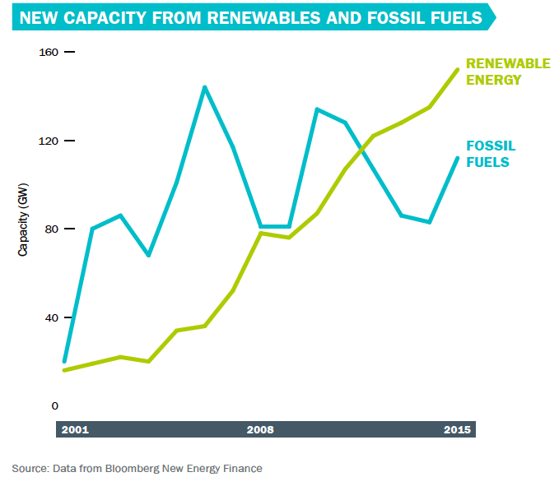
Renewables are now capturing lion’s share of new energy generation capacity
Visualizing sustainable solutions

Slide 13
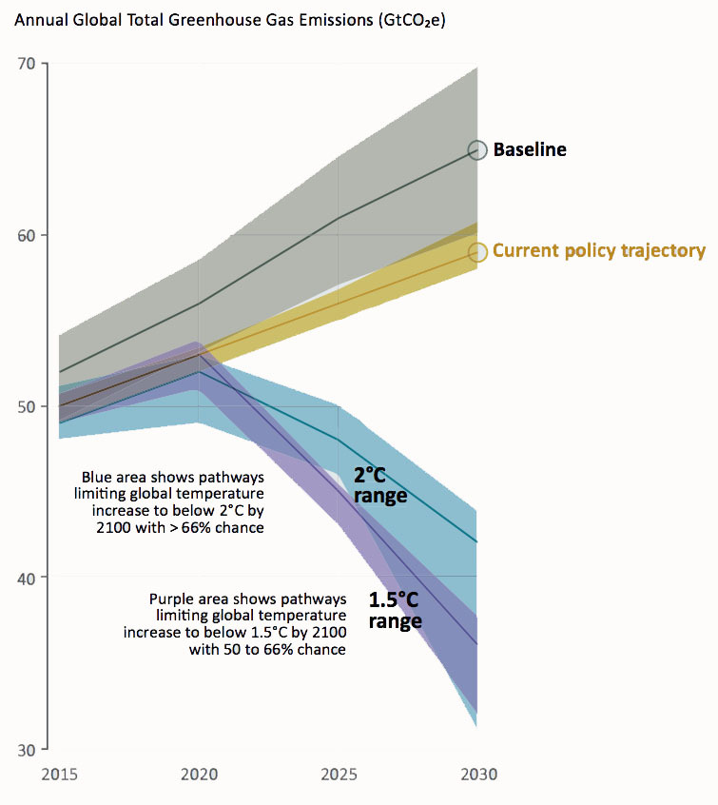
So what’s the problem?
1992:
87% of primary energy from
fossil fuels
2017:
85% of primary energy from
fossil fuels
Only a 2% gain
in 25 years!
Renewable uptake is way too slow.
Paris Agreement
IPCC
Visualizing sustainable solutions

Slide 14
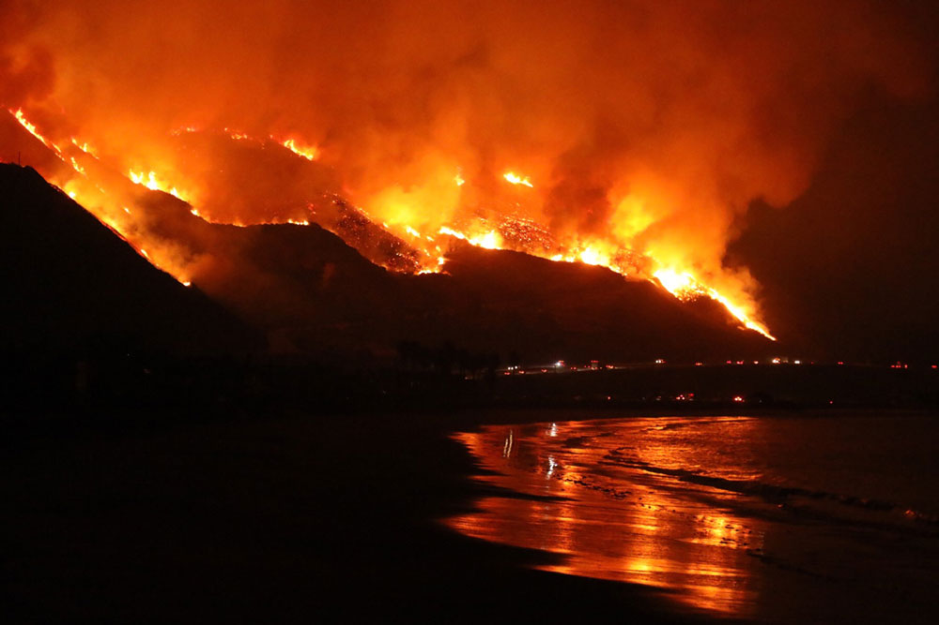
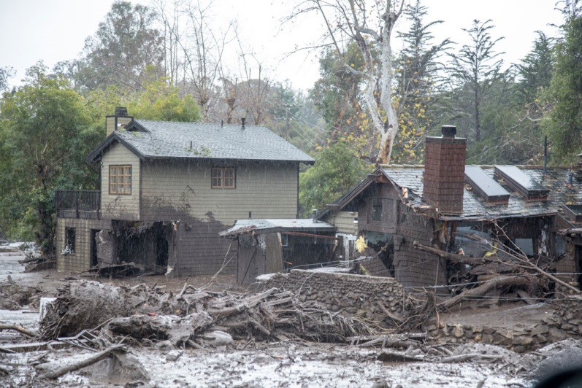
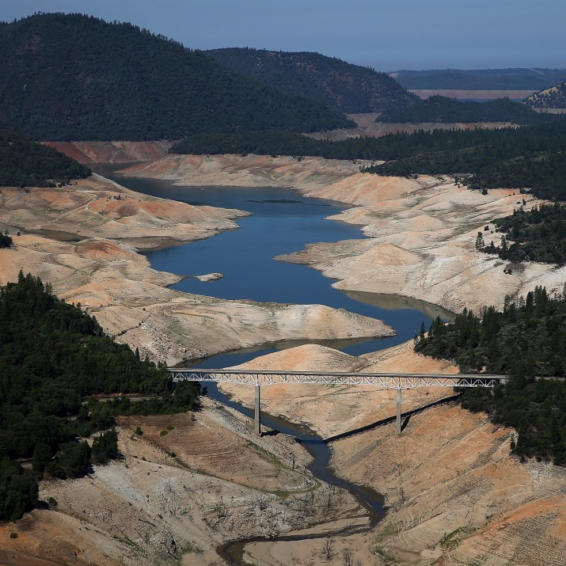
What are the consequences now?
Montecito Flood
Thomas Fire
Lake Oroville 2014
Visualizing sustainable solutions

Slide 15

How are engineers doing?
Visualizing sustainable solutions

Slide 16
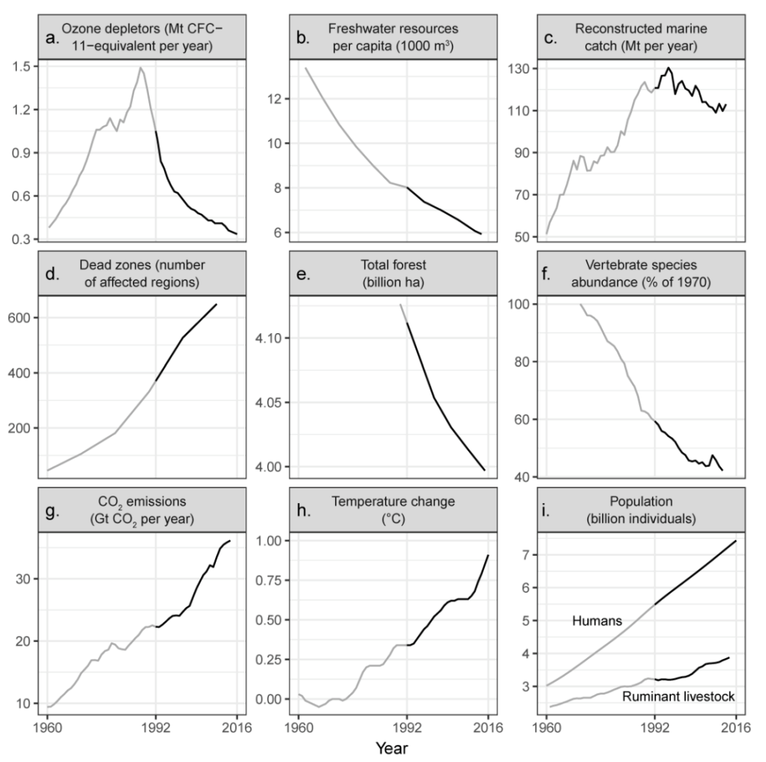
World Scientists’ 2nd Global Warning to Humanity
From
1992 to 2016:
8 of 9 threats have gotten worse in the past 25 years.
Alliance of
World Scientists
William J. Ripple et al
Visualizing sustainable solutions

Slide 17
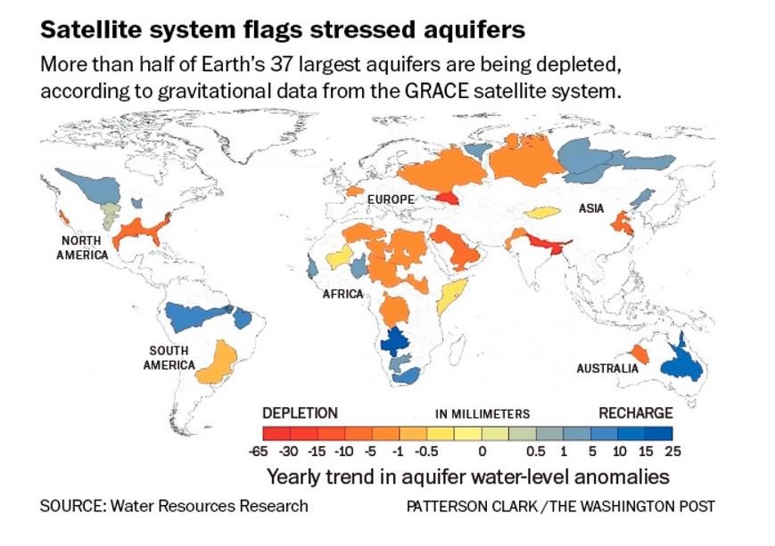
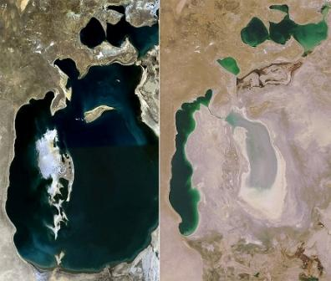
Aquifer Depletion
Aral Sea
Visualizing sustainable solutions

Slide 18
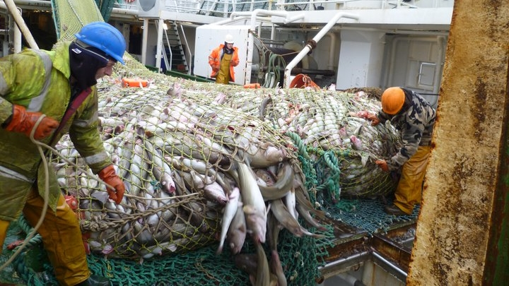
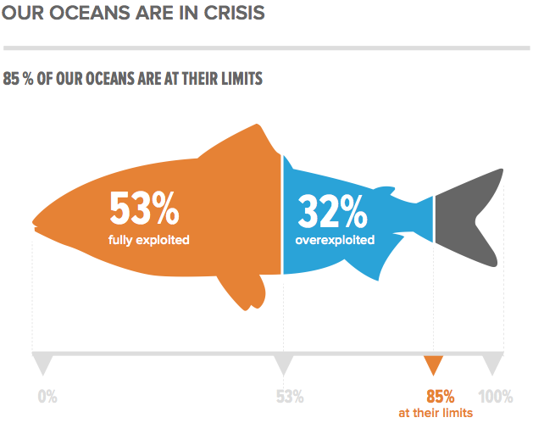
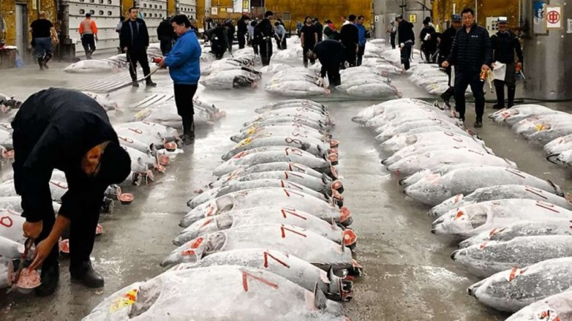
Fishery Depletion
Factory fishing ships
Visualizing sustainable solutions

Slide 19
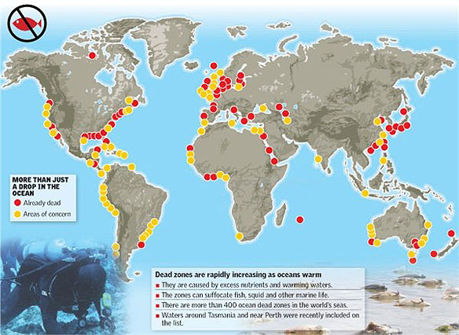
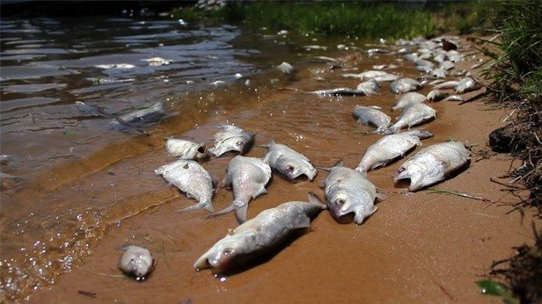
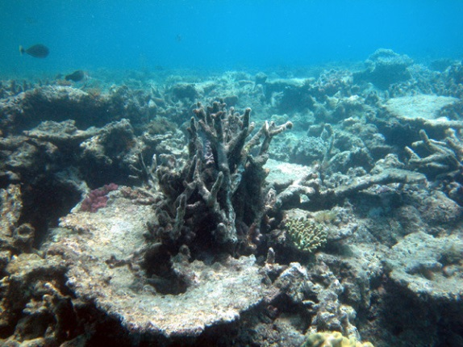
Dead Zones increasing
Chesapeake Bay
Great Barrier Reef
UNEP
Visualizing sustainable solutions

Slide 20
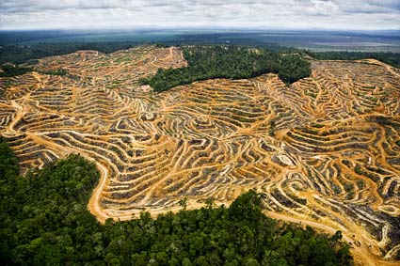
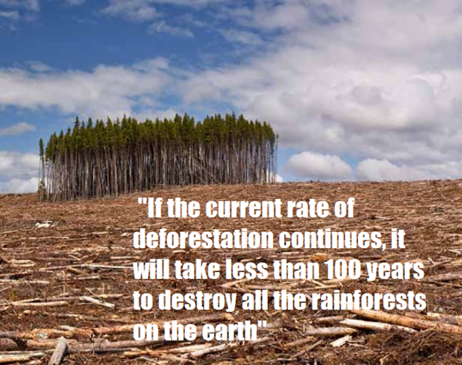

Deforestation
causes 20% of CO2 emissions
NASA Earth Observatory
Visualizing sustainable solutions

Slide 21
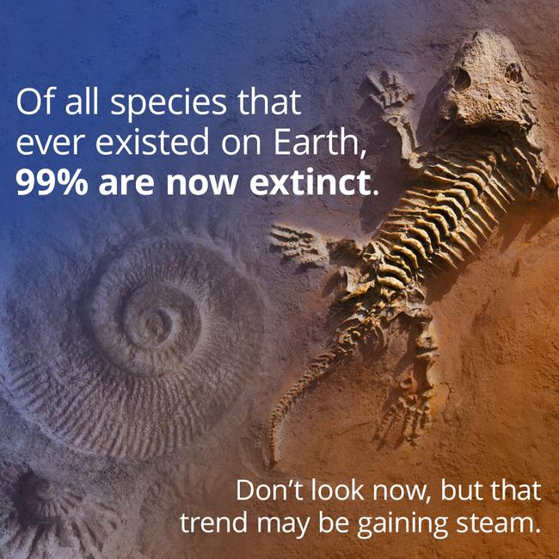
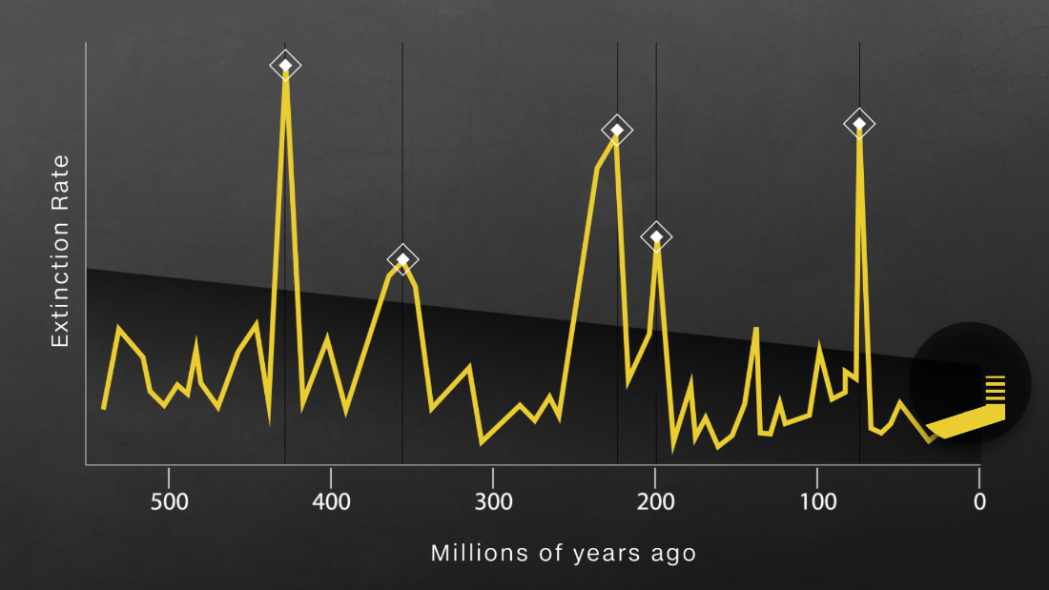

Species extinction
60% lose of invertebrate species since 1970 ... caused by us.
Center for Biological Diversity
Visualizing sustainable solutions

Slide 22
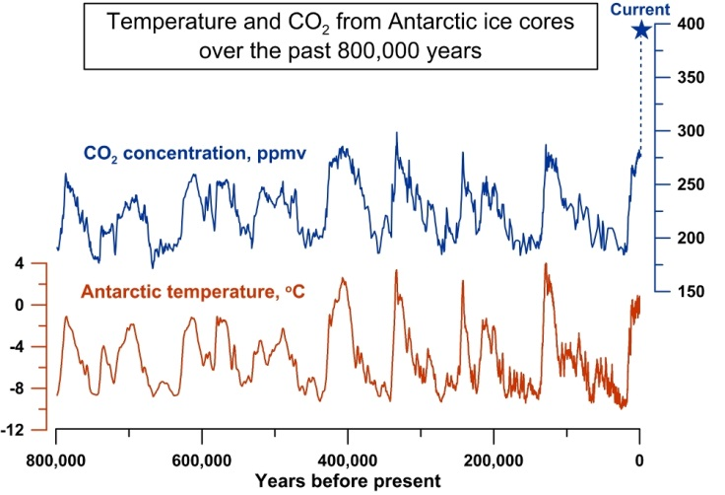
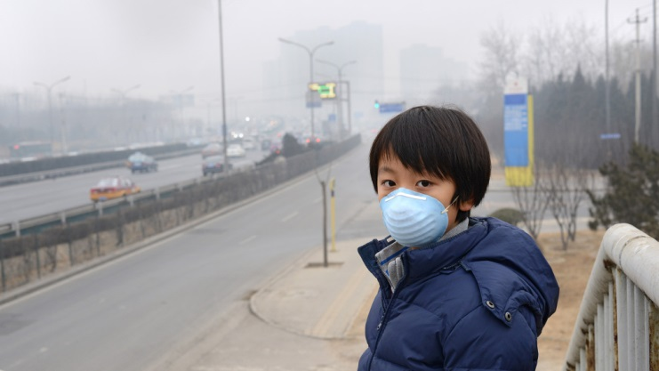
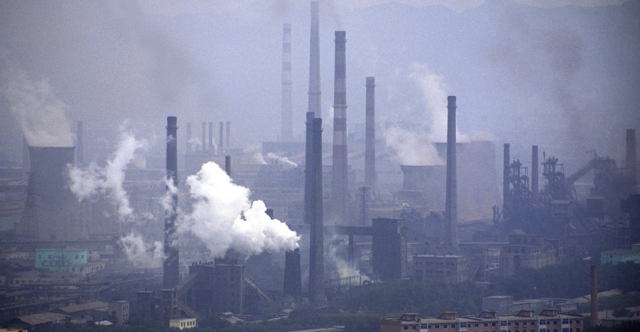
CO₂ Emissions
China pollution affects us all
Image: Jeremy Shakun/Harvard University
and requires us to solve this together
Visualizing sustainable solutions

Slide 23
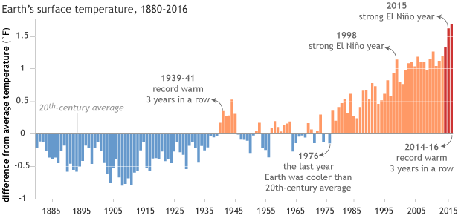
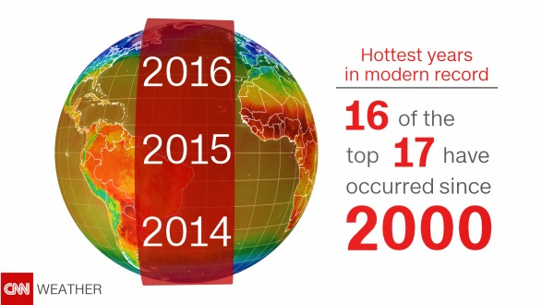
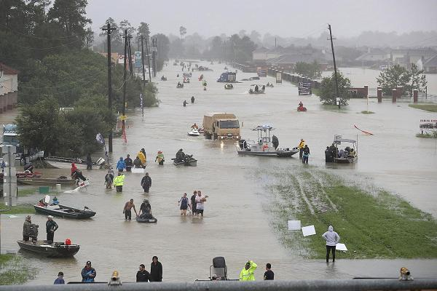
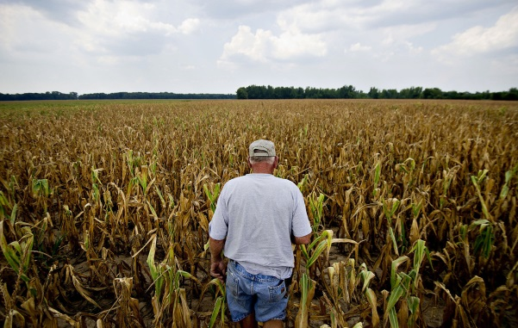
Temperatures increasing
New Orleans
GISS Surface
Temperature Analysis,
NASA
Iowa
Visualizing sustainable solutions

Slide 24
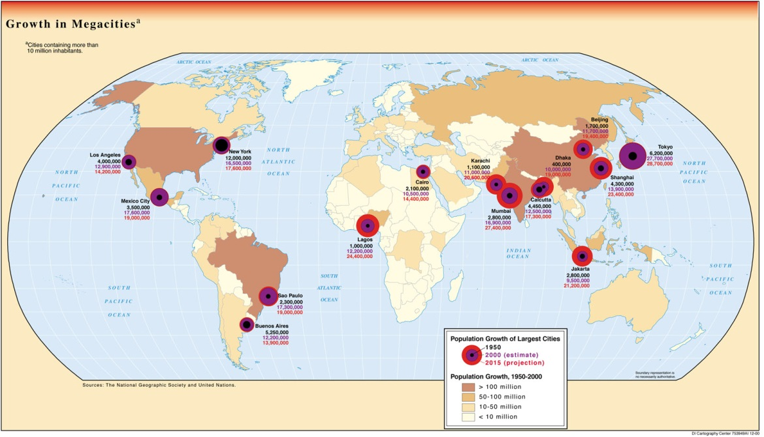
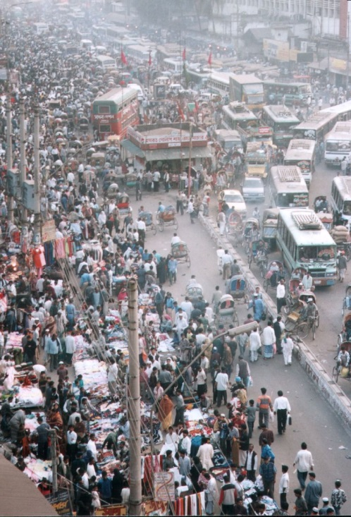

Population growth
10 billion people by 2050 – moving into urban areas
Dhaka
National Geographic Society
And United Nations
Visualizing sustainable solutions

Slide 25

Our problems are growing faster than our collective ability to solve them
What’s missing?
Scale
Speed
Optimal design
Across all nations
Visualizing sustainable solutions

Slide 26
Where do we go to grapple
with the most challenging issues
of our time?
Visualizing sustainable solutions

Slide 27

We need an accelerator
Visualize past trends and future projections
Provides immersive experience
Collaborative problem solving
Interconnected – we learn faster together.
For researchers, engineers, economists, educators, business leaders and policy makers to design, fund and build solutions quicker.
Visualizing sustainable solutions

Slide 28
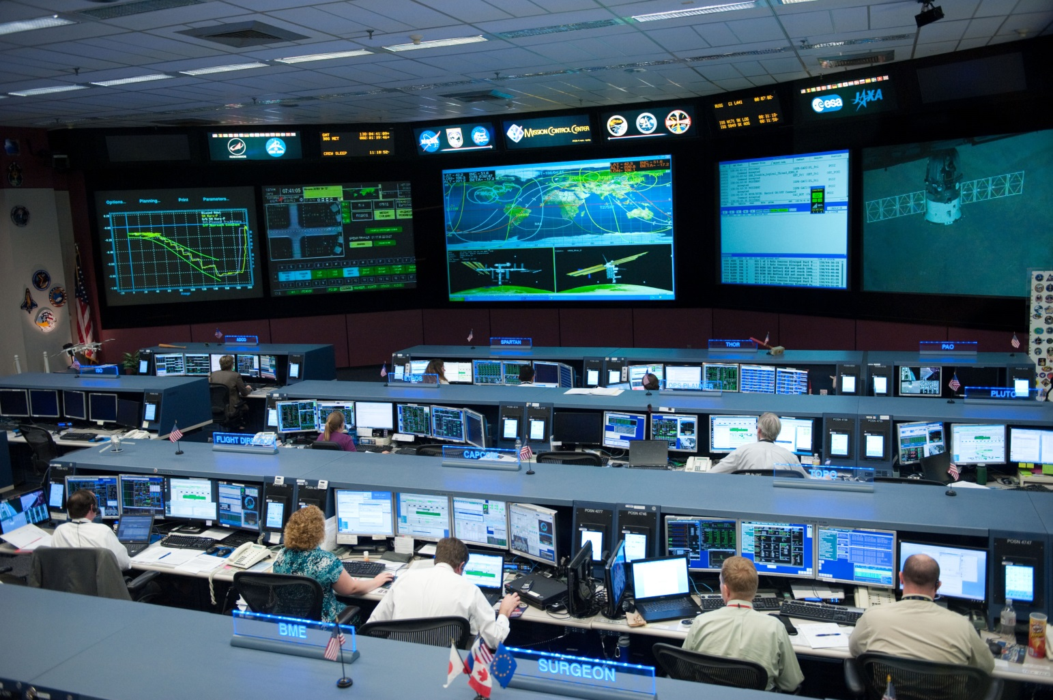
We have control rooms for space
NASA
Visualizing sustainable solutions

Slide 29
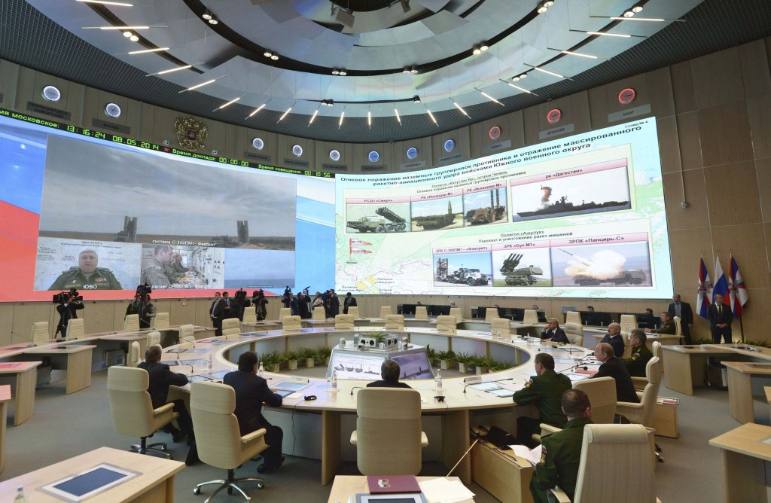
Control rooms for war
Moscow
Visualizing sustainable solutions

Slide 30
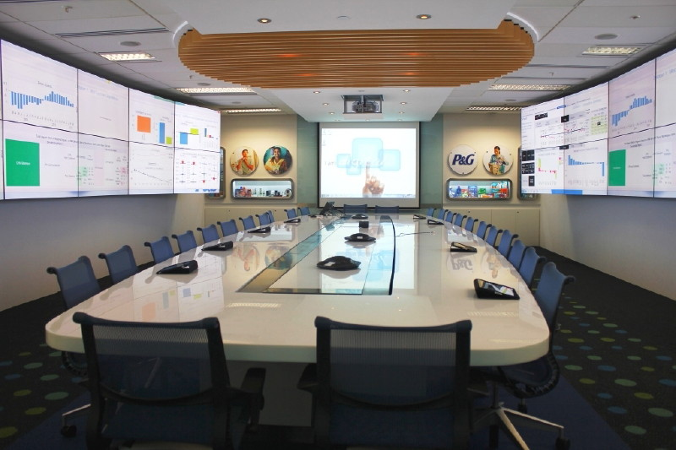
Control rooms for business
P&G
Visualizing sustainable solutions

Slide 31
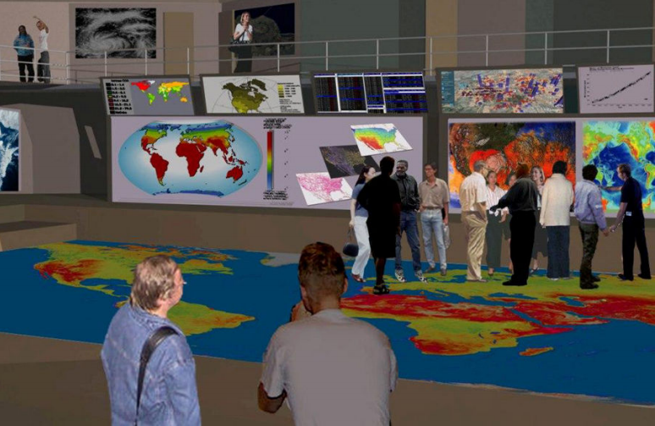
Why not a Mission Control for global sustainability?
Visualizing sustainable solutions

Slide 32
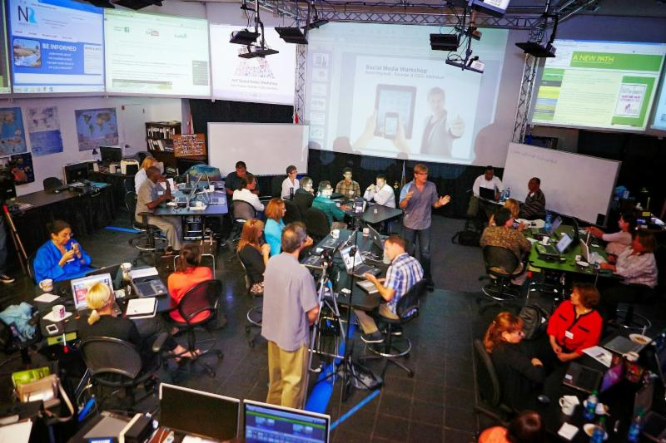
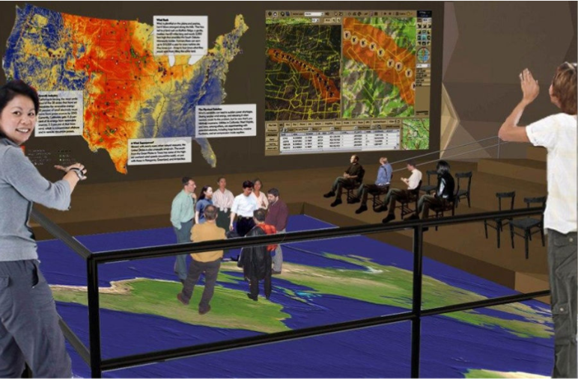
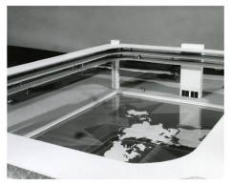
where we can visualize solutions, share strategies and measure results
What’s needed today
San Diego demo
Vision in 1969
Visualizing sustainable solutions

Slide 33
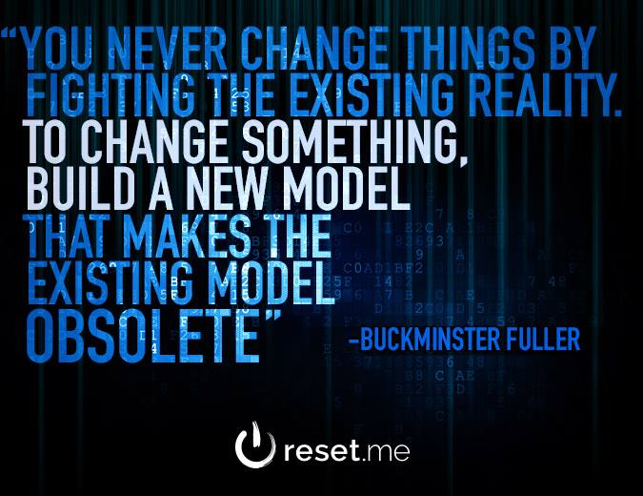
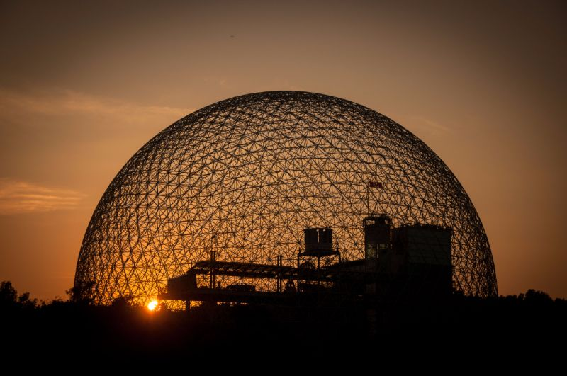

The SIMCenter was originally proposed for the Montreal Dome in 1967
Visualizing sustainable solutions

Slide 34
World Resources Simulation Center
  Visualizing sustainable solutions
  to global and local problems
  so society makes
  informed choices quicker
  …. because we are running out of time!
Visualizing sustainable solutions

Slide 35
We have control rooms for space, war and business -- why not for global sustainability?
Visualizing sustainable solutions

Slide 36
How do we get it done? What’s needed:
Space – on university or corporate campuses
5,000–20,000 sq. ft.
Technology – latest visualization tools, digital floor, simulation and communication software
Funding - $2 million/year for staff & operations
Institutional Partners, Smart people – committed engineers, regional planners, GIS mappers, IT developers, sustainability researchers and students.
Visualizing sustainable solutions

Slide 37
Why are we here:
to foster technological innovation and excellence for the benefit of humanity.
to be essential to the global technical community everywhere in improving global conditions.
to solve problems.
Visualizing sustainable solutions

Slide 38
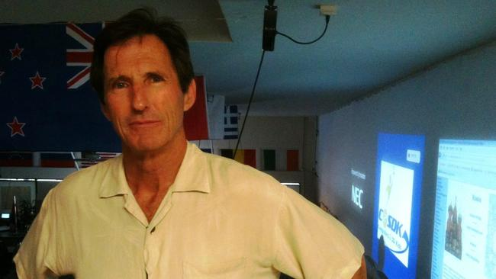
Thank you!
Join us in making a global impact:
Peter Meisen, Director
Global Energy Network Institute
www.geni.org
www.wrsc.org
619-595-0139
peter@geni.org
Visualizing sustainable solutions

